Slide 1
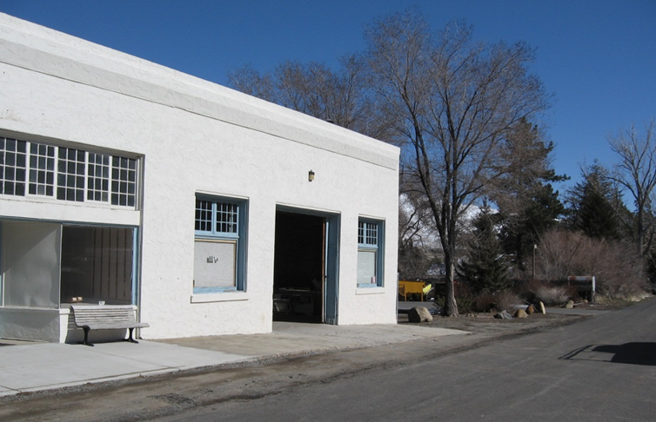
Washoe County Board of Adjustment
April 6, 2017
Special Use Permit Case Number WSUP17-0001
(Verdi Reclaimed Lumber – Custom Manufacturing)

Slide 2
Case Description
For possible action, hearing, discussion, to approve a special use permit to allow custom manufacturing [industrial] use type.

Slide 3
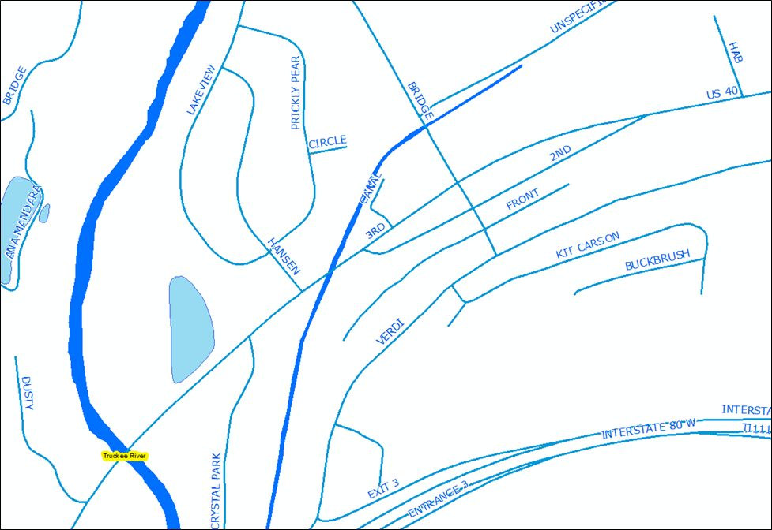
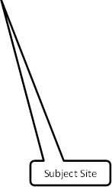
Vicinity Map

Slide 4
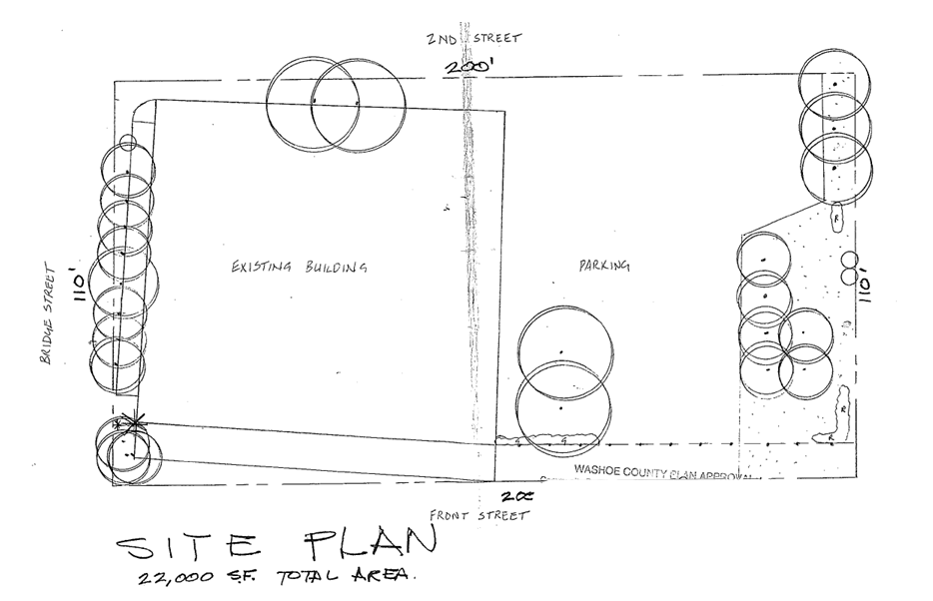
Site Plan

Slide 5
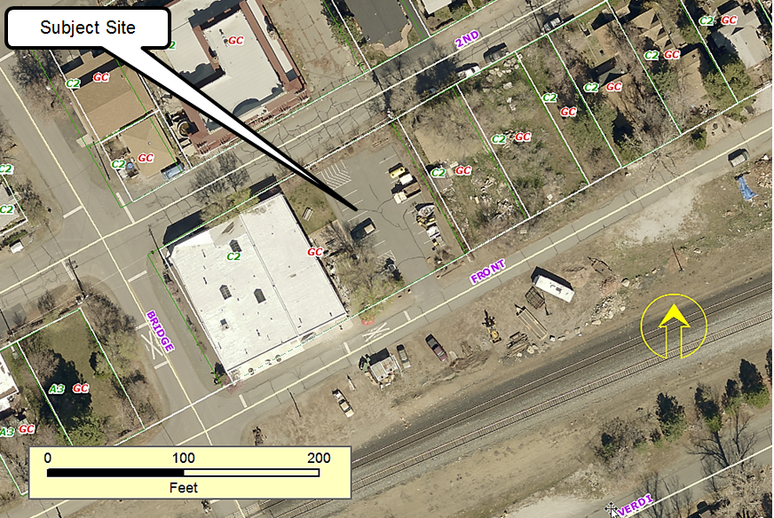
Overhead Photo of Subject Site

Slide 6
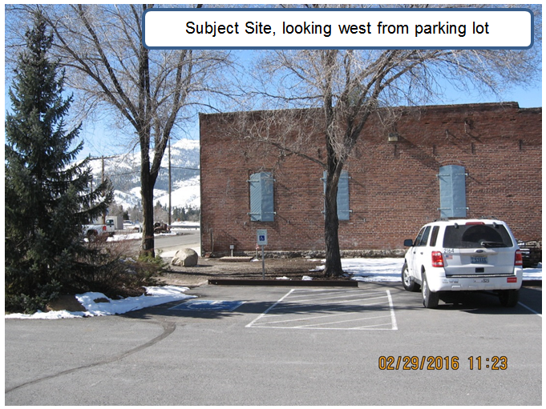
Current Photo of Subject Site

Slide 7
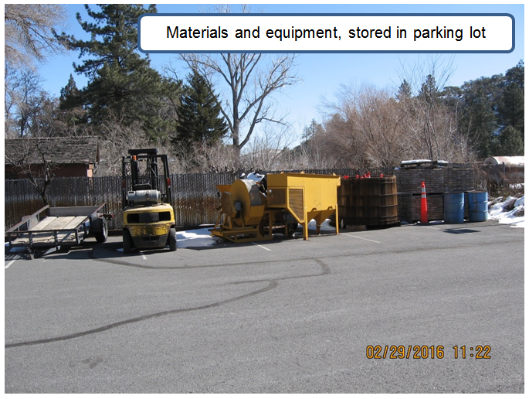
Current Photo of Subject Site

Slide 8
Background
Seeking approval of a custom manufacturing industrial use type
Existing commercial building on a parcel with the General Commercial (GC) regulatory zone
Proposed use consists of using reclaimed lumber to manufacture custom furniture
Landscaping will be improved to meet Code requirements
Equipment and materials will not be stored in parking lot

Slide 9
Analysis
Minimal impacts anticipated
Activity to take place within existing building

Slide 10
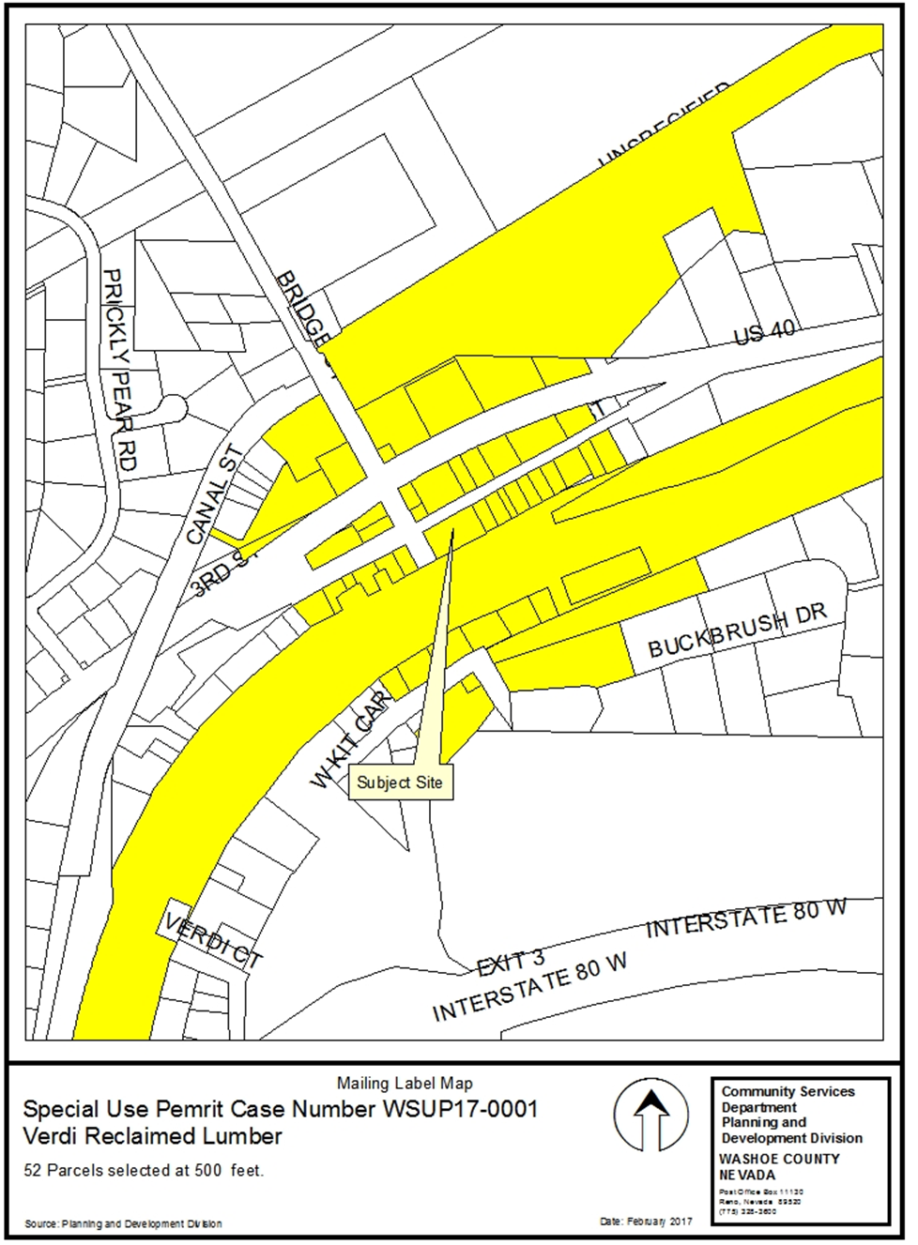
Public
Notice

Slide 11
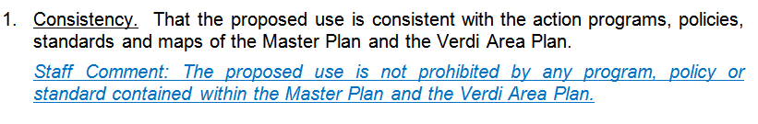
Administrative Permit Findings

Slide 12
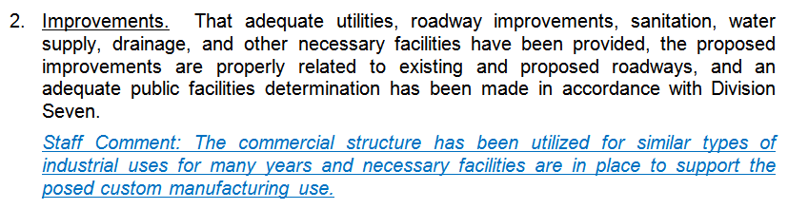
Administrative Permit Findings

Slide 13
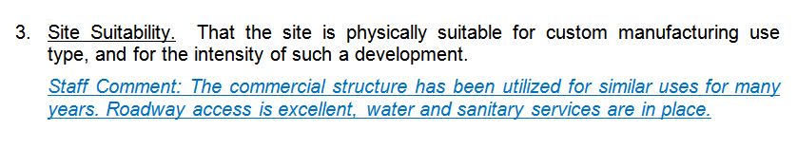
Administrative Permit Findings

Slide 14
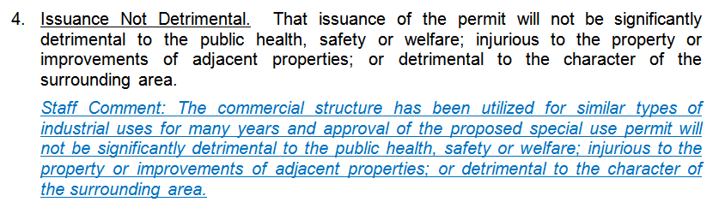
Administrative Permit Findings

Slide 15
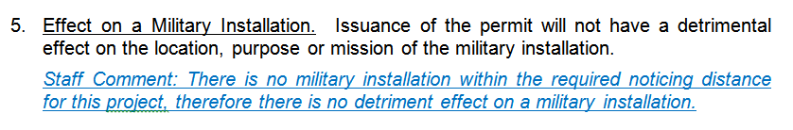
Administrative Permit Findings

Slide 16
Recommendation
After a thorough analysis and review, Special Use Permit Case Number WSUP17-0001 is being recommended for approval with conditions.

Slide 17
Possible Motion
I move that, after giving reasoned consideration to the information contained in the staff report and information received during the public hearing, the Washoe County Board of Adjustment approve Special Use Permit Case Number WSUP17-0001 for Alex James Gonzalez, with conditions of approval included at Exhibit A to this report, having made all five findings in accordance with Washoe County Development Code Section 110.810.30

Slide 18
Questions?

